Slide 1
STA513 Final Project Musa 2023
EXPL ANALYSIS WITHin the NIDA PsYchosocial Treatments for Cocaine DepedEnce Study
(1999, AGP/AMA)

Slide 2
The outcome ANALYZED is EXPL which is MEASURED WITHIN the Inventory of Interpersonal Problems (IIP) Exploitive Subscale
The inventory of interpersonal problems is a self-report inventory that asks participants to rate a variety of interpersonal problems that may cause distress. Higher EXPL scores indicates a higher tendency to exploit.
The Exploitive Subscale examines the concepts of exploitation and exploitativeness, or unfairly using others for profit or advantage. Much of the interest in exploitativeness has stemmed from its connection with narcissism.
In a study by Boudewyn & Liem, high scorers on a measure of chronic self-destructiveness (the tendency to perform behaviors that later reduce positive consequences and increase the probability of experiencing negative ones reported experiencing more interpersonal exploitation, greater depression, lower self-esteem, more externalizing attitudes, and less control in relationships than low scorers) also engaged in more frequent acts of acute self-destructiveness.
Drug use is self-destructive behavior.

Slide 3
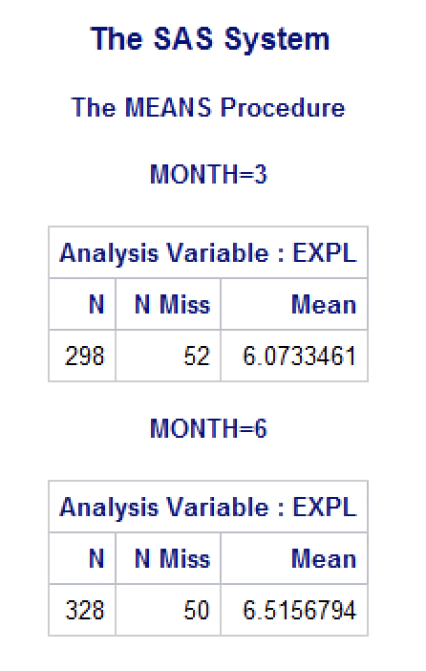
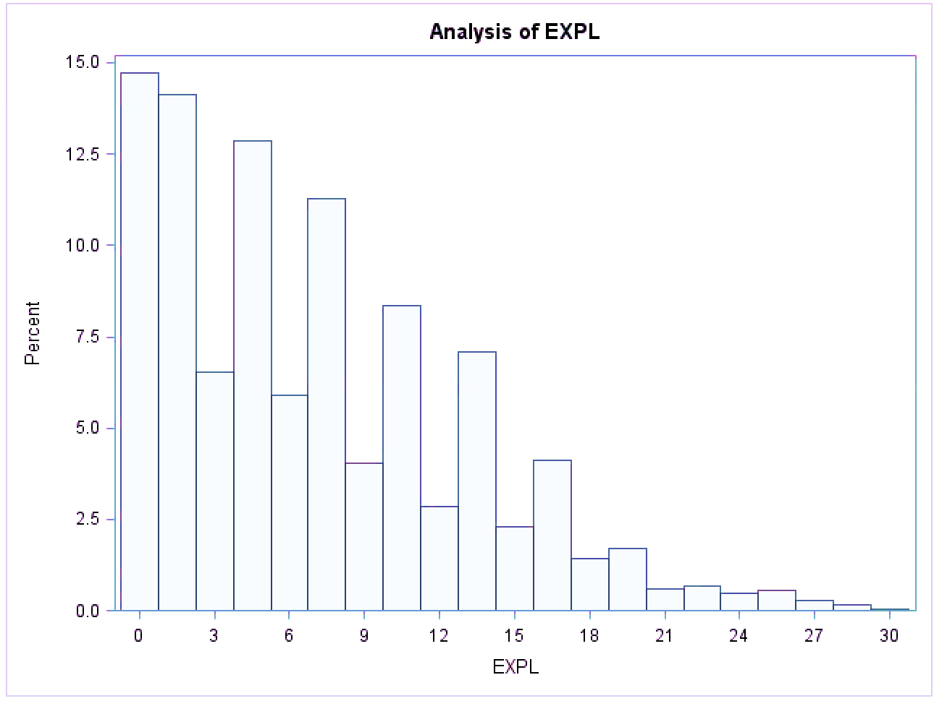
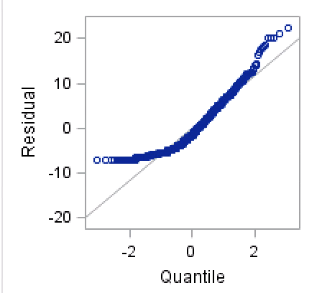
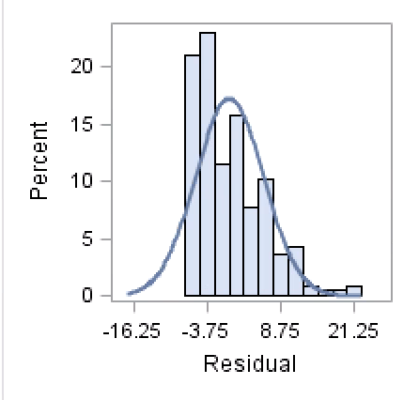
ABOUT THE DATA…
The sample size for month 3 is 298 with 52 missing data values.
The sample size for month 6 is 328 with 50 missing data values.
The EXPL distribution is skewed right indicating most participants have lower EXPL scores.
ASSUMPTIONS
No violation of homogeneity is found for the 3 month or 6 month cross sectional analysis.
The residuals are not distributed Normally (Shapiro-Wilk) at the 3 and 6 month cross sectional analysis for all of the modeling. A Boxcox transformation did not correct the residuals for either analysis. Therefore, any interpretation from these models should be considered with caution. Since the Boxcox transformation was not effective, the original data was used in the analysis.

Slide 4
One Way Anova (TX_Cond)
TX_COND defines four interventions.
1 = Individual Drug Counseling (IDC)
2 = Cognitive Therapy (CT)
3 = Supportive Expressive Psychodynamic Therapy (SE)
4 = Group Drug Counseling (GDC)

Slide 5
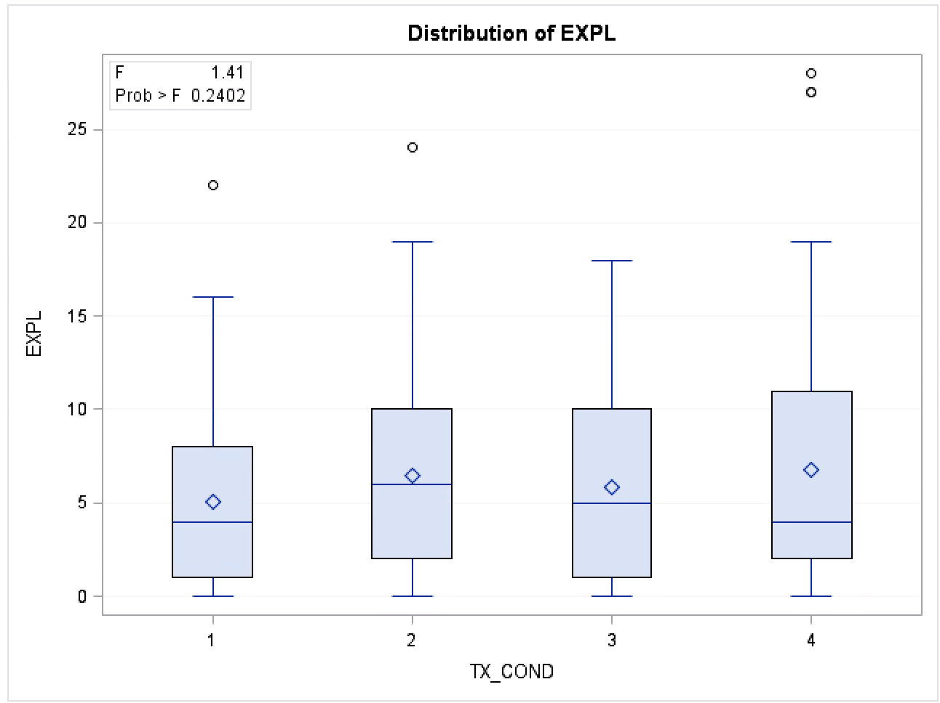
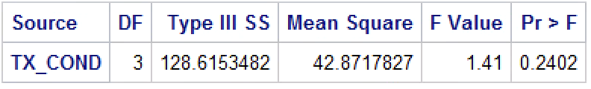
One way ANOVA: 3 Month Analysis
Based on the available data, we do not have evidence that EXPL varies differentially across the four levels of intervention after 3 months into the study.

Slide 6
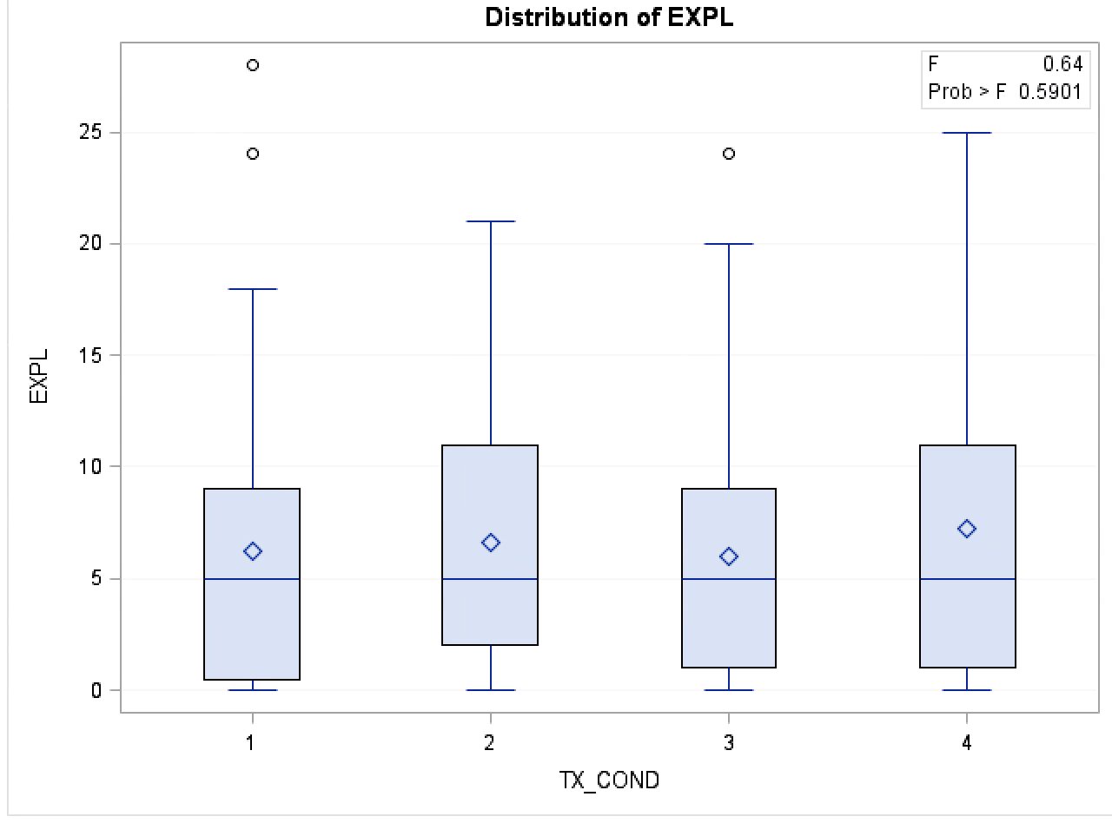

One way ANOVA: 6 MONTH ANALYSIS
Based on the available data, we do not have evidence that EXPL varies differentially across the four levels of intervention after 6 months into the study.

Slide 7
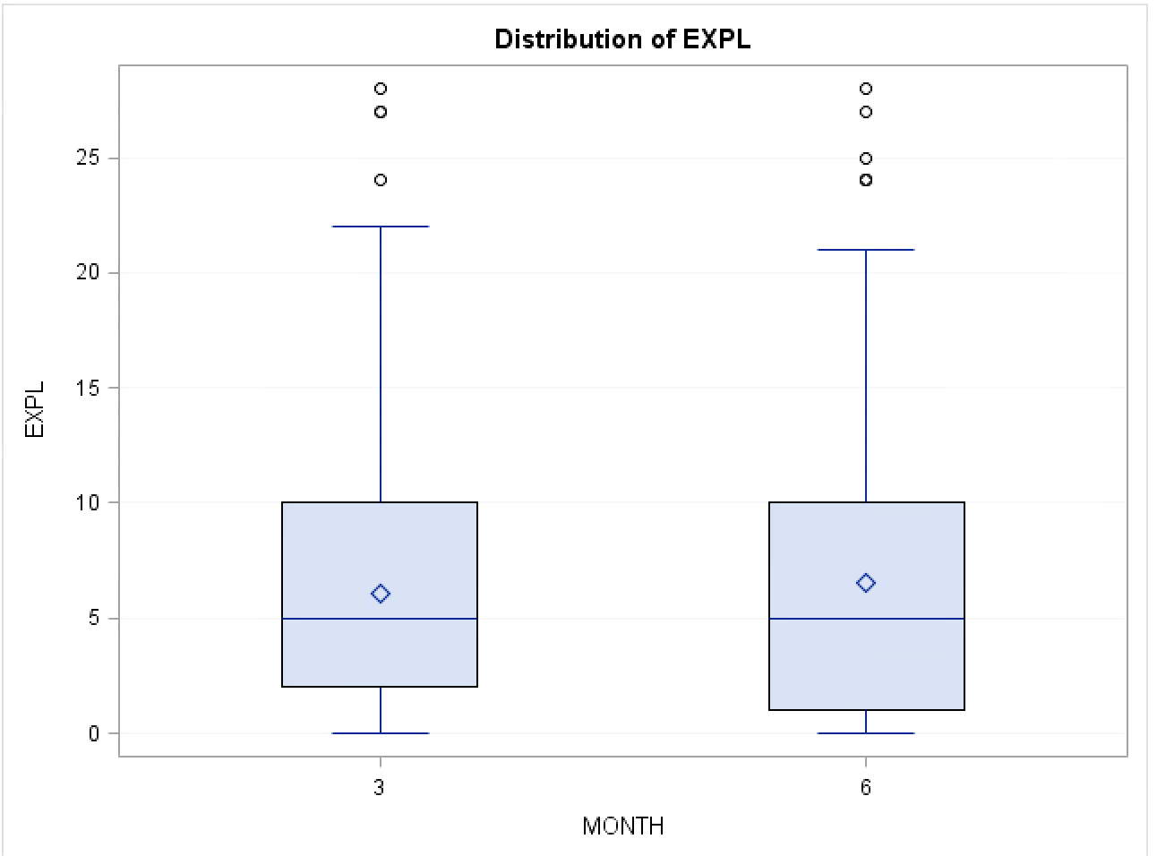
tX_COND Contrast: 3 Month vs 6 month
Based on the available data, we do not have sufficient evidence to indicate a significant difference in EXPL scores across the four intervention arms between month 3 and month 6 in the study.

Slide 8
Two way ANOVA analysis: RACE & JOB
RACE is defined by two levels.
0 = Non-Caucasian
1 = Caucasian
JOB is defined by two levels.
0 = Unemployed
1 = Employed

Slide 9
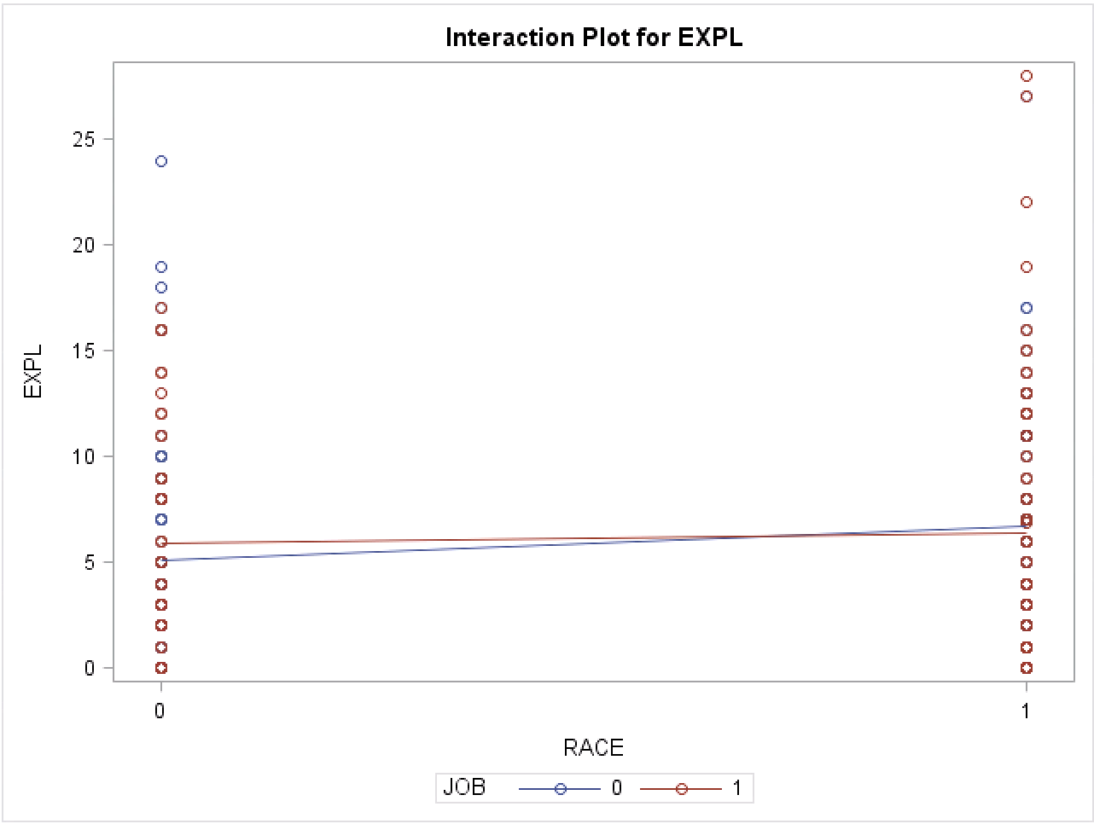
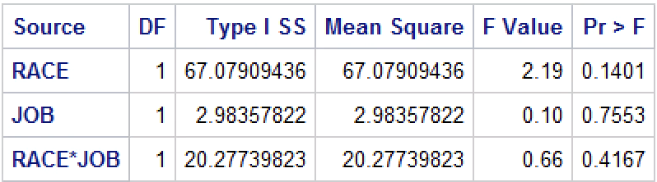
TWO WAY ANOVA MONTH 3: Race & Job
Based on the available data, we have do not have evidence that the on average EXPL score at month 3 across the two levels of race varies differentially across the two levels of employment.
When the two way interaction was removed, all main effects were insignificant.
JOB: blue = unemployed
Red = employed
RACE: 0 = Non-Caucasian
1 = Caucasian

Slide 10
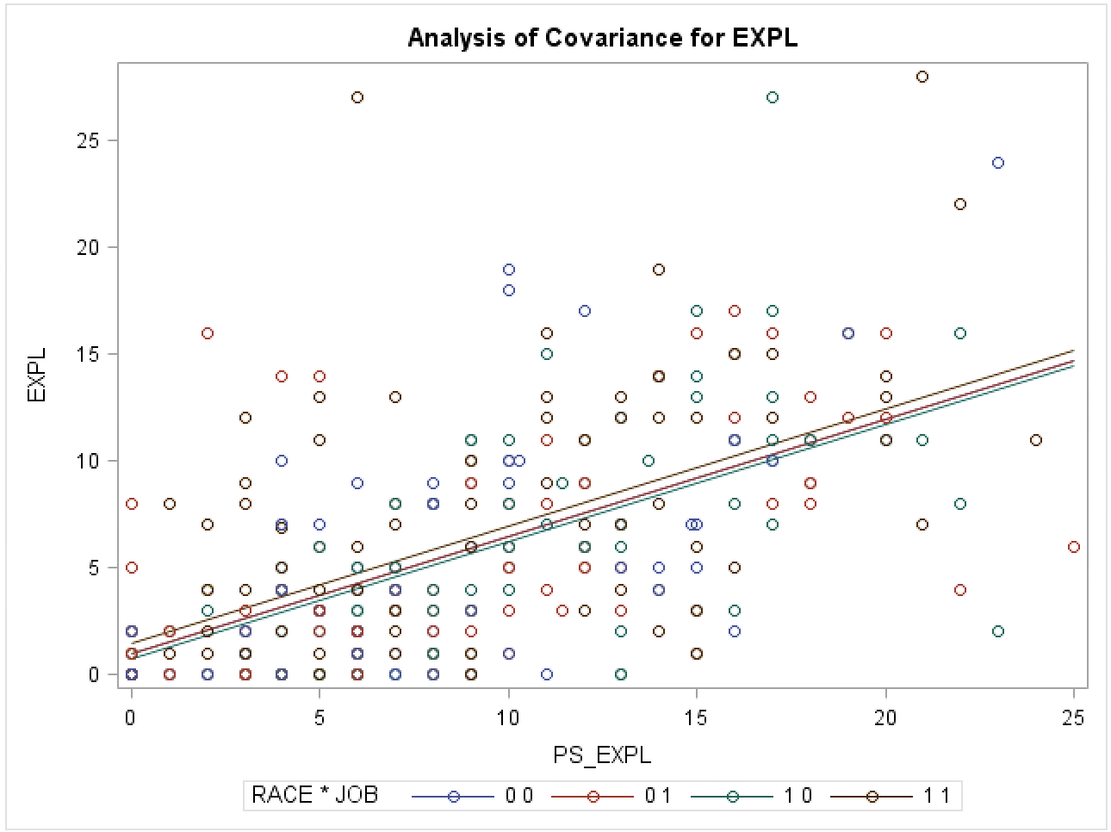
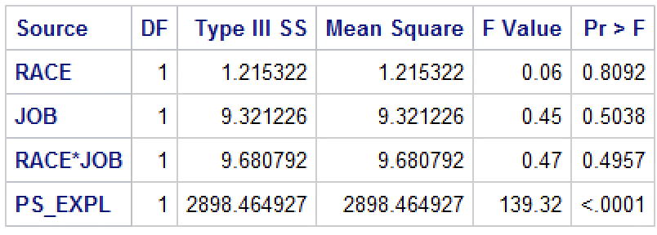
COVARiATE In the TWO WAY ANOVA MONTH 3: PS_EXP (Baseline EXPL)
Based on the available data, we do not have evidence that the on average EXPL score at month 3 across the two levels of race varies differentially across the two levels of employment when baseline EXPL is added to the model. In turn, baseline EXPL is a significant covariate.

Slide 11
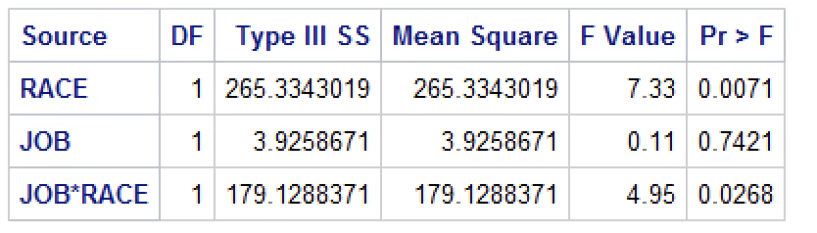
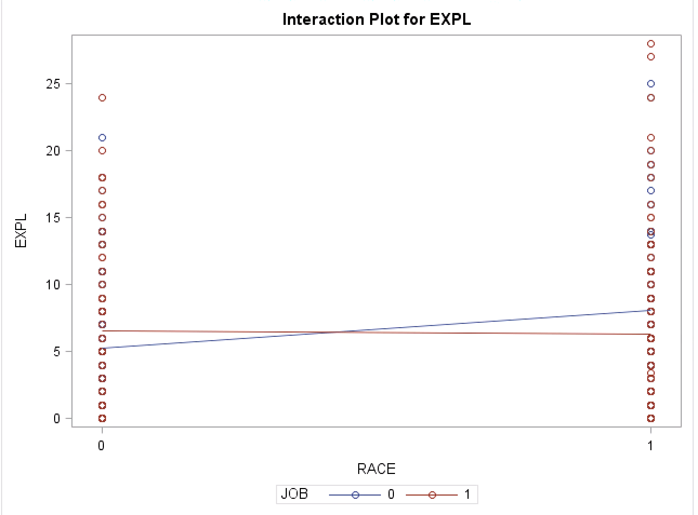
TWO way anova Month 6: race & Job
There appears to be a disordinal interaction between race and job when measuring EXPL.
Unemployed Non-Caucasians had lower on average EXPL scores than Non-Caucasians who were employed.
The opposite is observed with Caucasians. Caucasians who were employed had lower on average EXPL score than unemployed Caucasians.
Based on the available data, we have evidence that the on average EXPL score at month 6 across the two levels of race varies differentially across the two levels of employment. In turn, the differences in average EXPL that varies across race depends on job.
When the interaction was removed from the model, the main effects were insignificant.
JOB: blue = unemployed
Red = employed
RACE: 0 = Non-Caucasian
1 = Caucasian

Slide 12
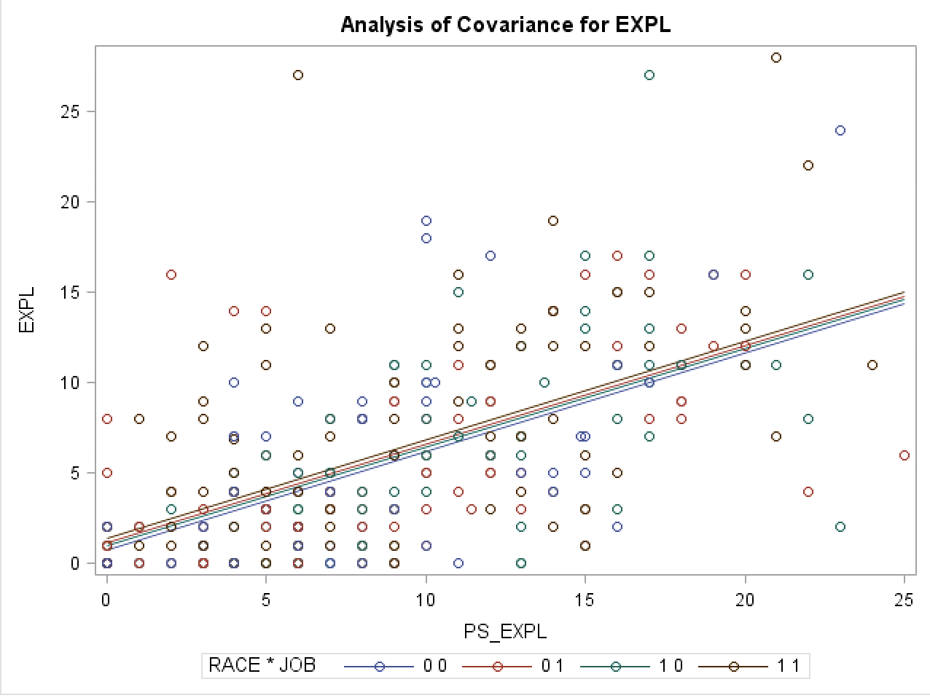
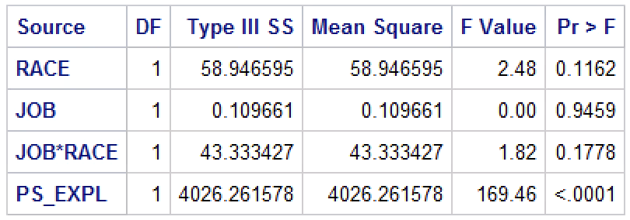
COVARiATE In the TWO WAY ANOVA MONTH 6: PS_EXP (Baseline EXPL)
Baseline EXPL (PS_EXPL) is added to the model as a covariate for EXPL. Based on the available data, we do not have evidence that the on average EXPL score across the two levels of race varies differentially across the two levels of employment when adjusting for baseline EXPL at the 6 month time point in the study.
In turn, baseline EXPL is, in fact, a statistically significant covariate for EXPL. When the data is adjusted for baseline EXPL (when the data is controlled for baseline) the interaction of race and job is no longer significant.

Slide 13
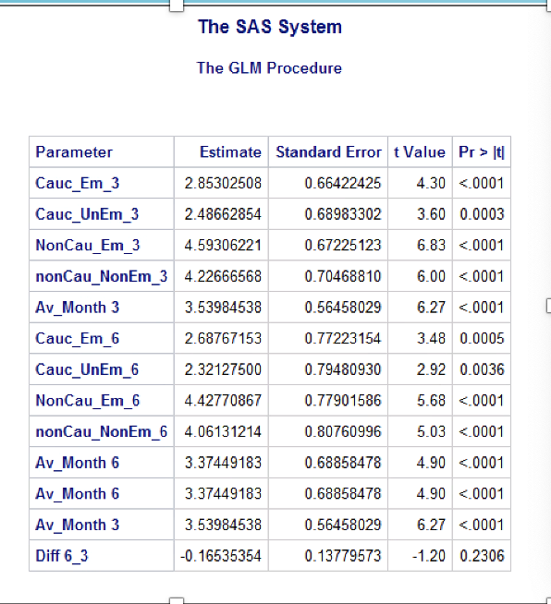
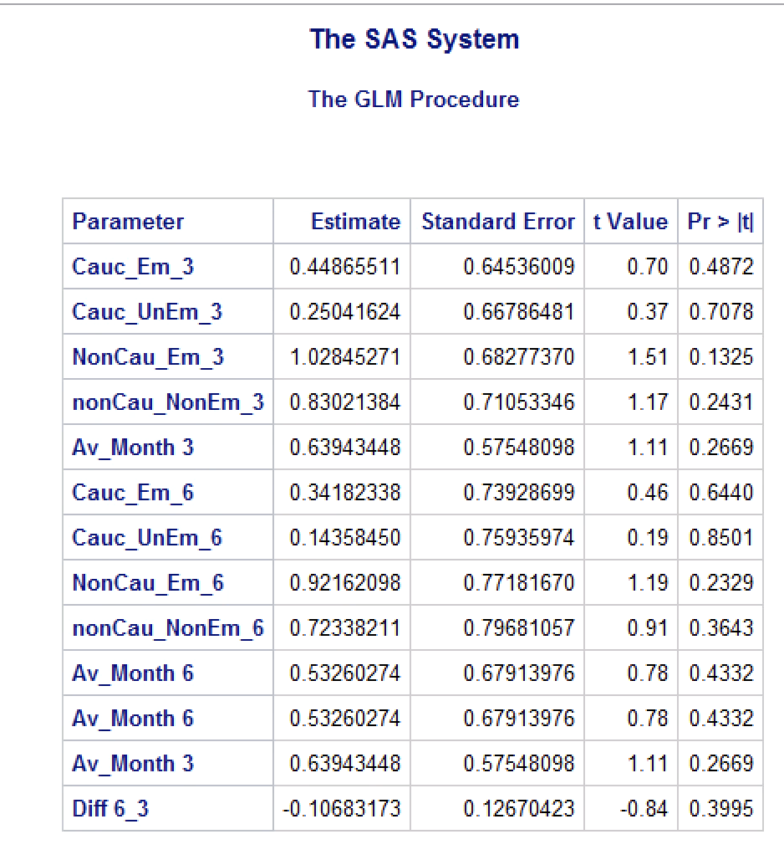
Contrast month 3 and MONTH 6
Without baseline EXPL
With baseline EXPL
Based on the available data, we do not have evidence that the on average EXPL score between month 3 and month 6 across the two levels of race varies differentially across the two levels of job with and without adjusting for baseline EXPL.

Slide 14
THREE way ANOVA analysis: Mar_stat, JOB, crack
MAR_STAT
0 = Married/Cohabitation
1 = Lives alone
JOB
0 = Unemployed
1 = Employed
CRACK
0 = Cocaine (IV or snort)
1 = Crack

Slide 15
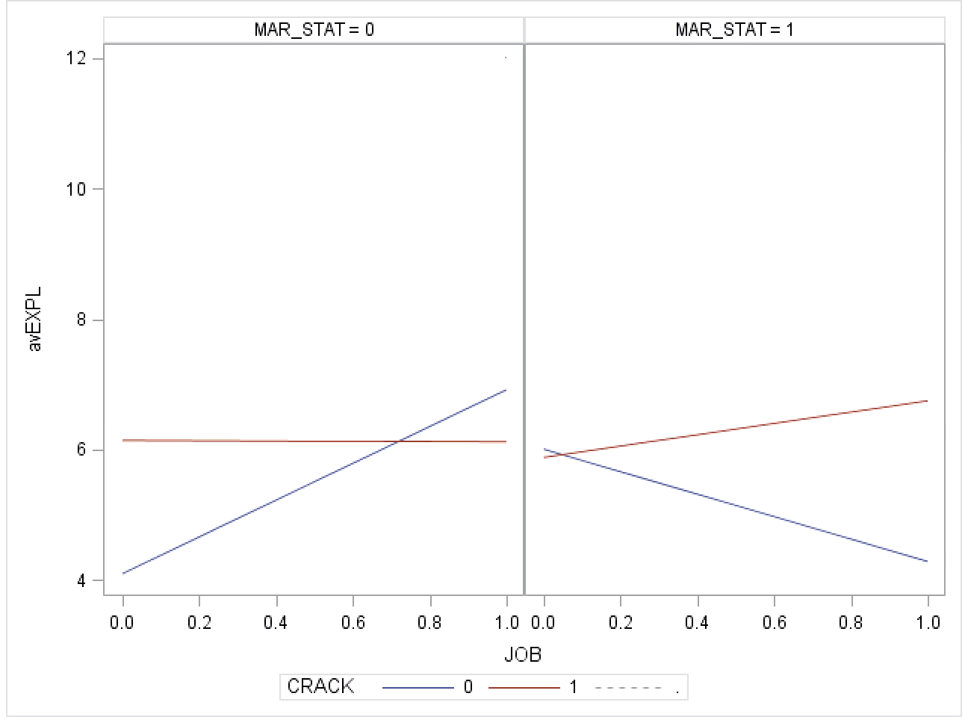
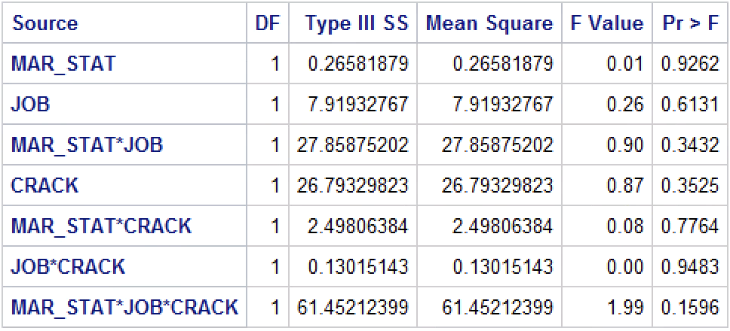
THREE WAY ANOVA MONTH 3: Mar_Stat, Job, CRACK
ALONE
MARRIED
Based on the available data, we do not have sufficient evidence to indicate the on average EXPL score at month 3 between the two levels of marital and the two levels of employment varies differentially across the two levels of crack.
Cocaine
Crack
The Alone panel and Married panel have different patterns indicating a possible three way interaction. There also appears to be a possible disordinal relationship between job and crack based on the plot. However, analysis indicates insignificant interactions.
When the three way interaction was removed, all two way interactions were insignificant. In fact, all main effects were also insignificant.

Slide 16
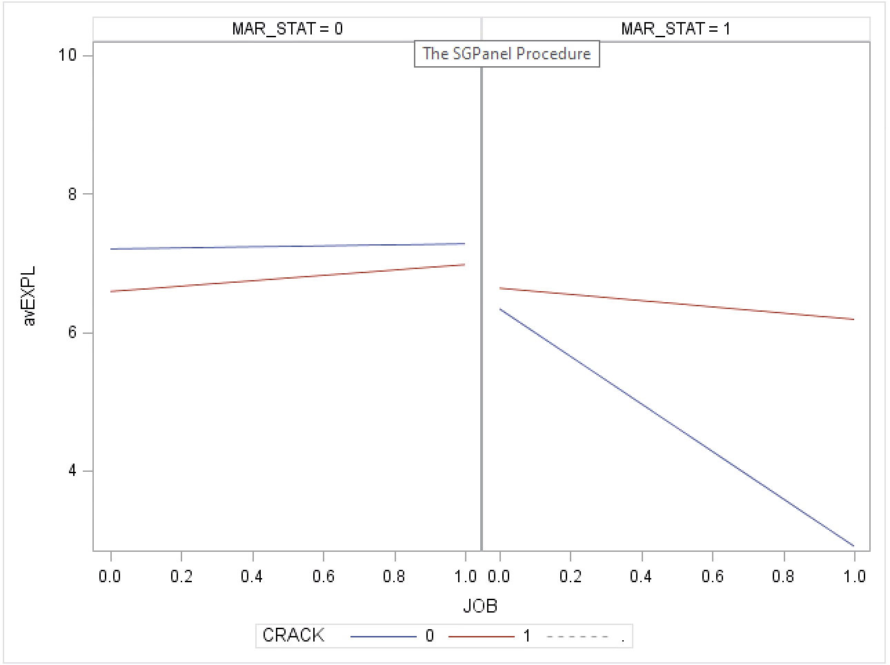
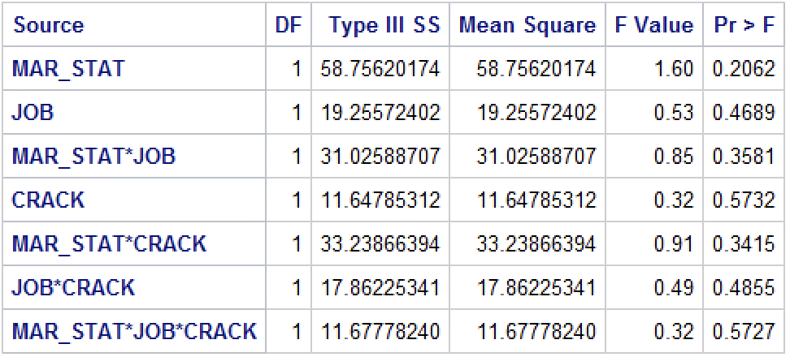
Three way ANOVA month 6: Mar_stat, job, crack
ALONE
MARRIED
Based on the available data, we do not have sufficient evidence to indicate the on average EXPL score at month 6 between the two levels of marital and the two levels of employment varies differentially across the two levels of crack.
Cocaine
Crack
When the three way interaction was removed, all two way interactions were insignificant. In fact, all main effects were also insignificant.
The patterns across the two panels appear to differ indicating a possible three way interaction. There also appears to be a possible main effect of crack and employment for married participants. However, analysis indicates insignificant interactions.

Slide 17
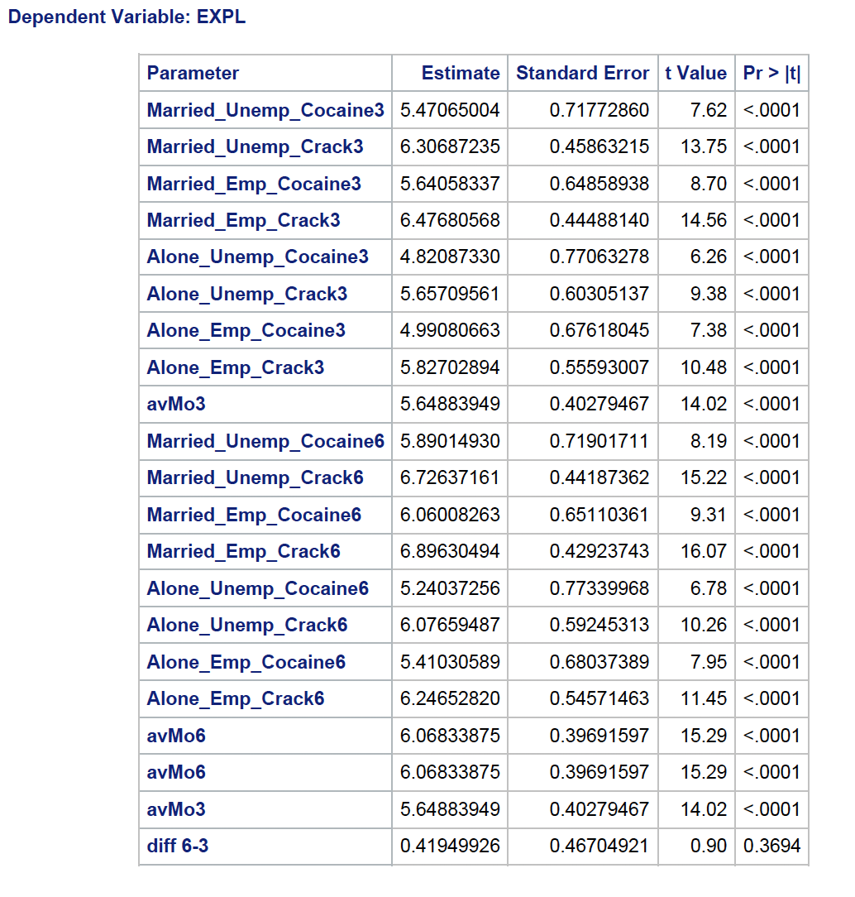
Contrast: Mar_stat, job, crack for months 3 & 6
Based on the available data, we do not have evidence that the on average EXPL score across marital status varies differentially across job status varying across crack use from month 3 to month 6 in the study.

Slide 18
CONCLUSION
Most of the findings in this report are insignificant. Treatment intervention, race, job, marital status, and crack use, and interactions between some of the variables, were not significant predictors of EXPL at month 3, month 6, and contrasted between the two time points.
The interventions in the study are drug-based. Interpersonal problems are better treated with Interpersonal Psychotherapy (IPT), Cognitive Behavioral Therapy (CBT), or Dialetical Behavioral Therapy (DBT).
Since dishonesty is associated with drug use, response bias in the data could also be impacting the analysis.
Lastly, due to the distribution of EXPL, stacking was observed and caused disruptions to Normality of the residuals. In turn, the findings may be not accurate.

Slide 19
CITATIONS
Boudewyn, A. C., & Liem, J. H. (1995). Psychological, Interpersonal, and Behavioral Correlates of Chronic Self-Destructiveness: An Exploratory Study. Psychological Reports, 77(3_suppl), 1283-1297. https://doi.org/10.2466/pr0.1995.77.3f.1283
Crits-Christoph P, Siqueland L, Blaine J, et al. Psychosocial Treatments for Cocaine Dependence: National Institute on Drug Abuse Collaborative Cocaine Treatment Study. Arch Gen Psychiatry. 1999;56(6):493–502. doi:10-1001/pubs.Arch Gen Psychiatry-ISSN-0003-990x-56-6-yoa8244

